Slide 1
TypeScript
Why Use TypeScript?

Slide 2
Why Is JavaScript Great?
Relatively Easy to Learn
Its All Over the Place
Tons of libraries, frameworks and helpers
Flexible & Versatile
Fast – Client Side

Slide 3
What is Missing (ES5)?
Class-Based Objects
Static Type Checking
Lack of Modularity
Lack of Proper Scoping
ES2015 Feature Support

Slide 4
TypeScript For The Win!
Static Type Checking
Object-based Classes
Modules – Import/Export
Let/Const Block Scoping
ES2015 Compatibility
Syntax closer to Java, Scala, etc

Slide 5
Static Type-checking
TypeScript allows us to check and assign the type of value of our variables, parameters and functions
Optional
Catch possible problems in the future
More robust, clean and more descriptive code
Better debugging

Slide 6
Common Types
String
Number
Boolean
Array[]
let name: string;
function foo(x : number, y: number): number {}
let add = function(x: number, y: number): number {};

Slide 7
Other Types
Any – Any type. Essentially disable type checking
Void – no type returned
Null & Undefined – Returns null or undefined
Tuple – Array with fixed number of elements
Enum – enumerated values
Generics – specify type constraints. Great for reuse

Slide 8
Object-based Classes
TypeScript offers the ability to use classes in JavaScript
Object Oriented Behavior
Move away from prototype-based inheritance
Better Encapsulation
Class Inheritance
Access Modifiers – Public, Private, Protected

Slide 9
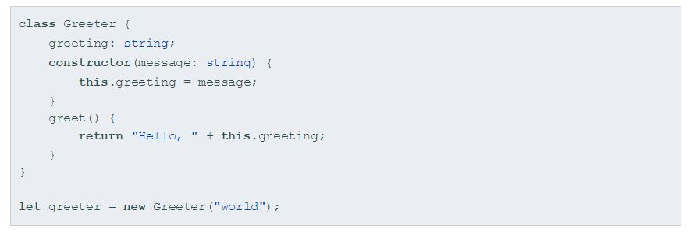
Simple Class

Slide 10
Variable Declarations & Block Scoping
let and const can now be used instead of var
let allows you to declare variables that are limited in scope to the block, statement, or expression on which it is used
const is an augmentation of let in that it prevents re-assignment to a variable

Slide 11
Interfaces
Interfaces allow us to name our types. Create a mapped out structure for objects and classes
Interface User {
name: string;
email: string;
}
Function getUser(user: User){
console.log(user.name);
}

Slide 12
Generic Types
Creates flexible and reusable classes and functions
Allows us to use a variable as a functions argument type and return type
We can also use generic interfaces
function identity<T>(arg: T): T {
return arg;
}

Slide 13


